Slide 1
Welded joints’ reactions
Welded structures under cyclical load

Slide 2
Welded structures under pulsating load
1 The trainer should explain how loading cyclically changes in time, and what the causes of cyclic loading are. 2 The trainer should give examples on how to improve microstructure of welded joints. 3 The trainer should demonstrate the action taken to reduce the fatigue in the completed fillet weld via video and pictures for the practice. Students should identify in the completed fillet weld how can soft edges can be achived (video and pictures for the practice during exercice). a) Convex fillet weld to reduce fatigue limit b) TIG dressing to improve fatigue limit; bottom edge of the fillet weld (video) c) TIG dressing to improve fatigue limit; bottom edge of the fillet weld (picture) d) TIG dressing to improve the fatigue limit; top edge of the fillet weld (video) e) TIG dressing to improve fatigue limit; full fillet weld (picture)

Slide 3
Gyakorlat neve | Welded structures under pulsating load
Solution | 1. The load changes at random or harmoniously in time. The change may affect both the degree of load change (eg. vibration amplitude) and its frequency (eg. vibration frequency). The lifetime of welded structures with dynamic loads depends on the fatigue strength of welded joints and structural elements. Load fluctuations can be repeated (swinging) or impact (high speed). Depending on the loading modes, we differentiate between pulsating and swinging stresses. Fatigue strength is determined by fatigue tests. Fatigue is significantly affected by the quality of surface, seam design, presence of notch-effects, sudden cross-sectional changes, nature of welded joints, etc
 | 2. Procedures for improving fatigue limitation: TIG dressing Flash removing Peening Stress reduction
 | 3. Procedures for improving fatigue limitation TIG dressing
 | a)Convex fillet to reduce fatigue limit (picture)
 | b) TIG dressing to improve fatigue limit; bottom edge of the fillet weld
 | c) TIG dressing to improve fatigue limit; bottom edge of the fillet weld
 | d) TIG dressing to improve fatigue limit; top edge of the fillet weld(video)
 | e )TIG dressing to improve fatigue limit; full fillet weld (photo)

Slide 4
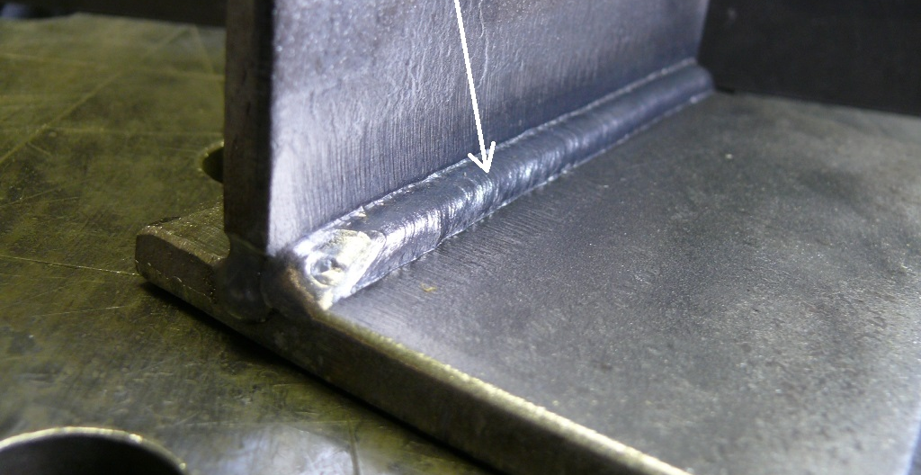
Convex fillet to
reduce fatigue limit

Slide 5
TIG dressing to improve fatigue limit bottom edge of the fillet weld

Slide 6
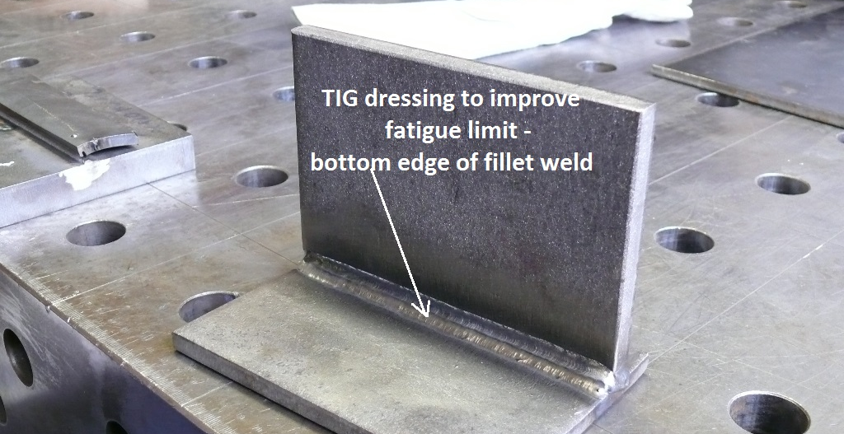
TIG dressing to improve fatigue limit
bottom edge of the fillet weld

Slide 7
TIG dressing to improve fatigue limit top edge of the fillet weld

Slide 8
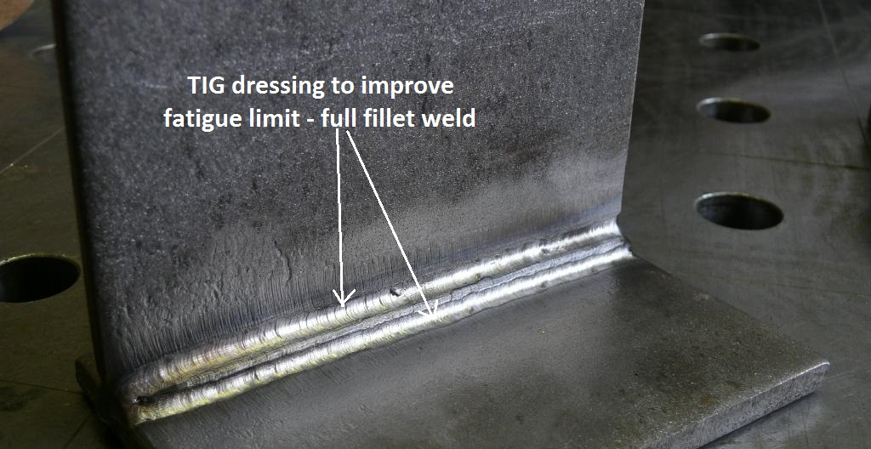
TIG dressing to improve fatigue limit
Full fillet weld

